Slide 1
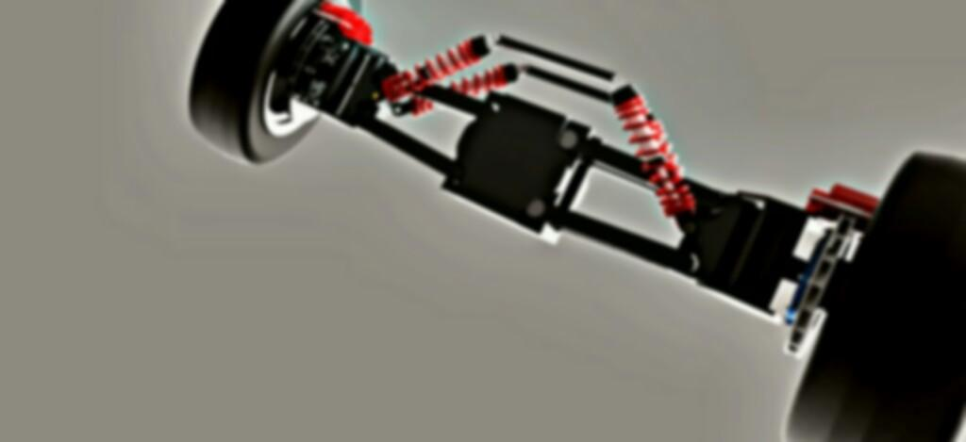


Smart India Hackathon 2020

Slide 2

Team name : Technothorn
Project name : Ultra-compact Personal Aerial Vehicle

Slide 3
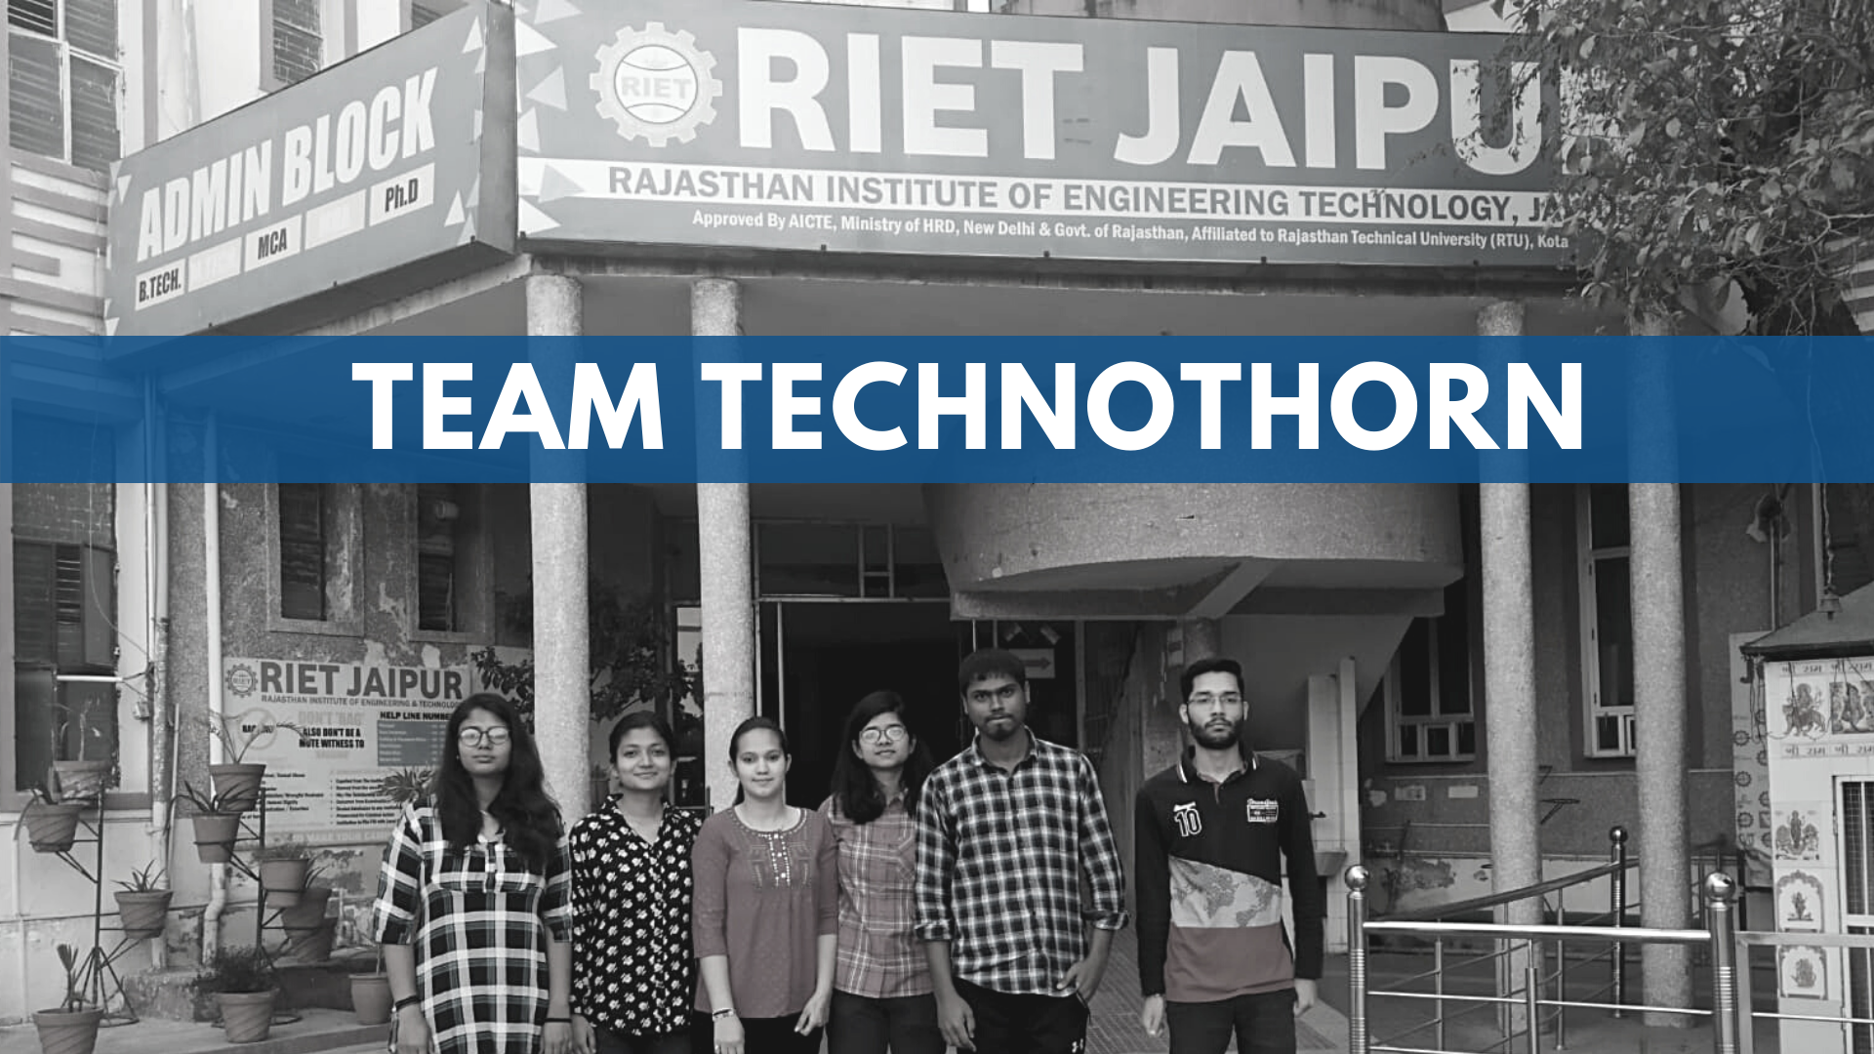

Slide 4
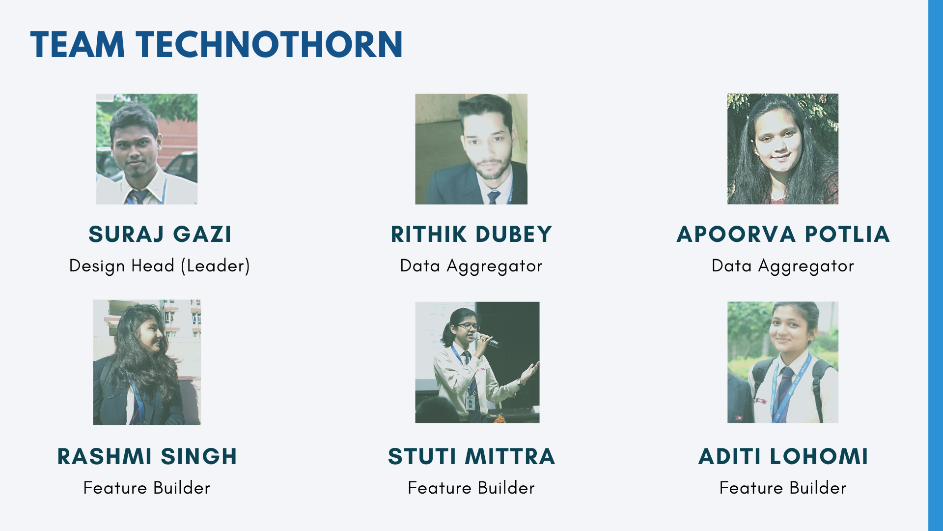
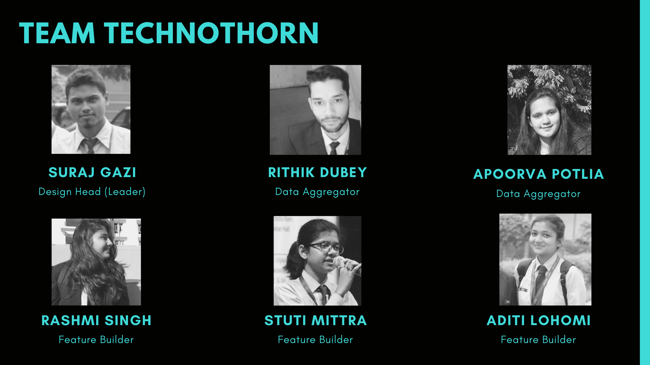

Slide 5
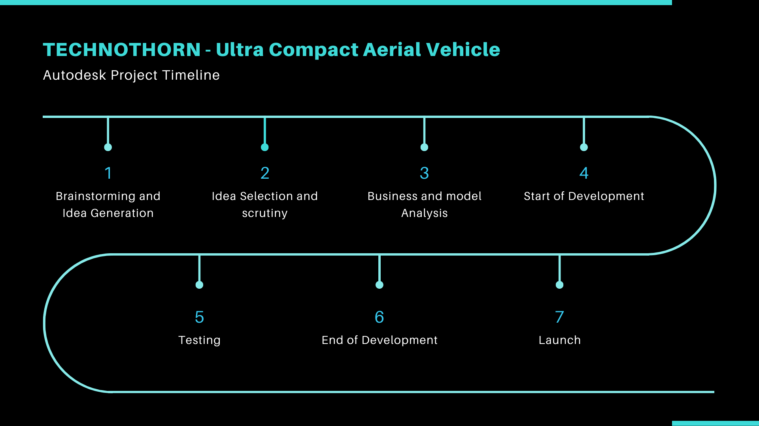
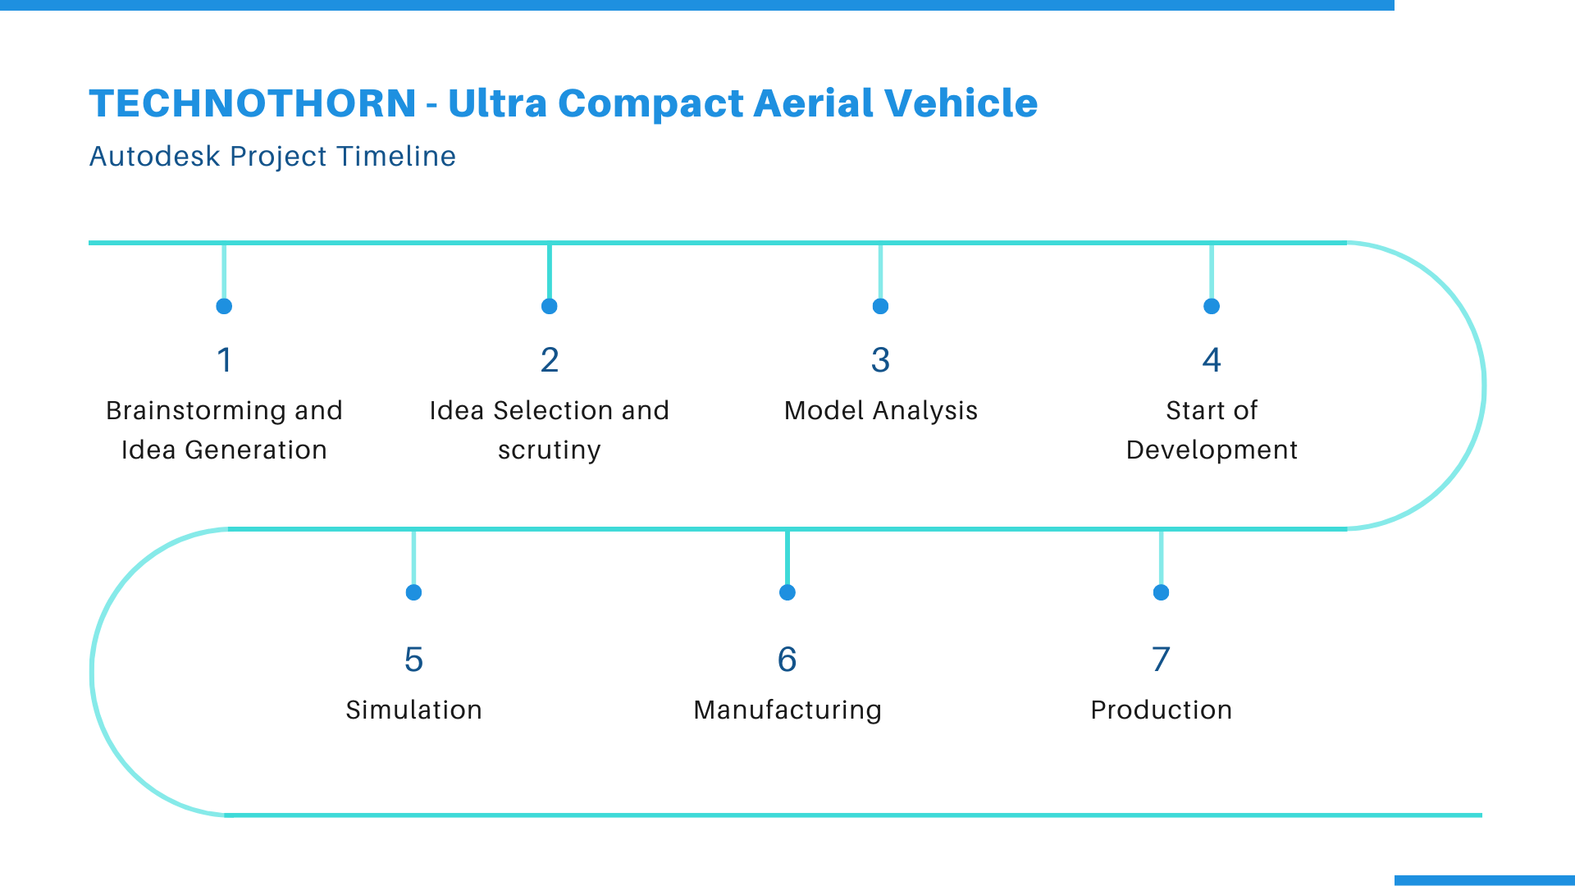

Slide 6


Slide 7
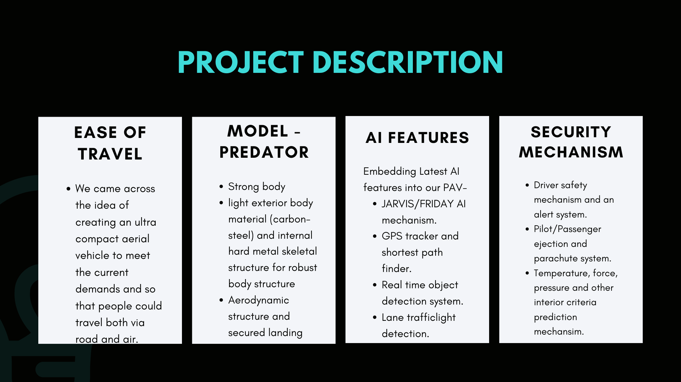
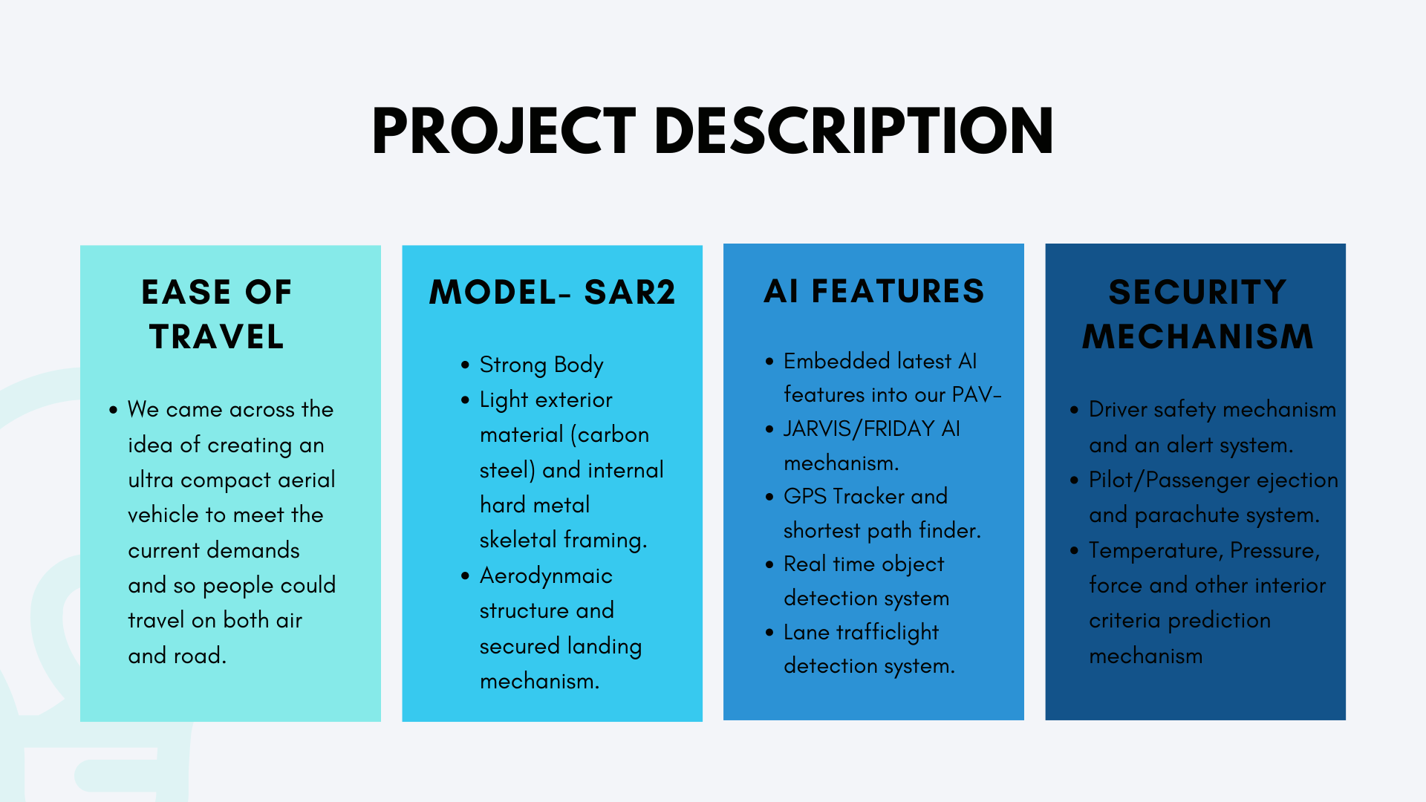


Slide 8
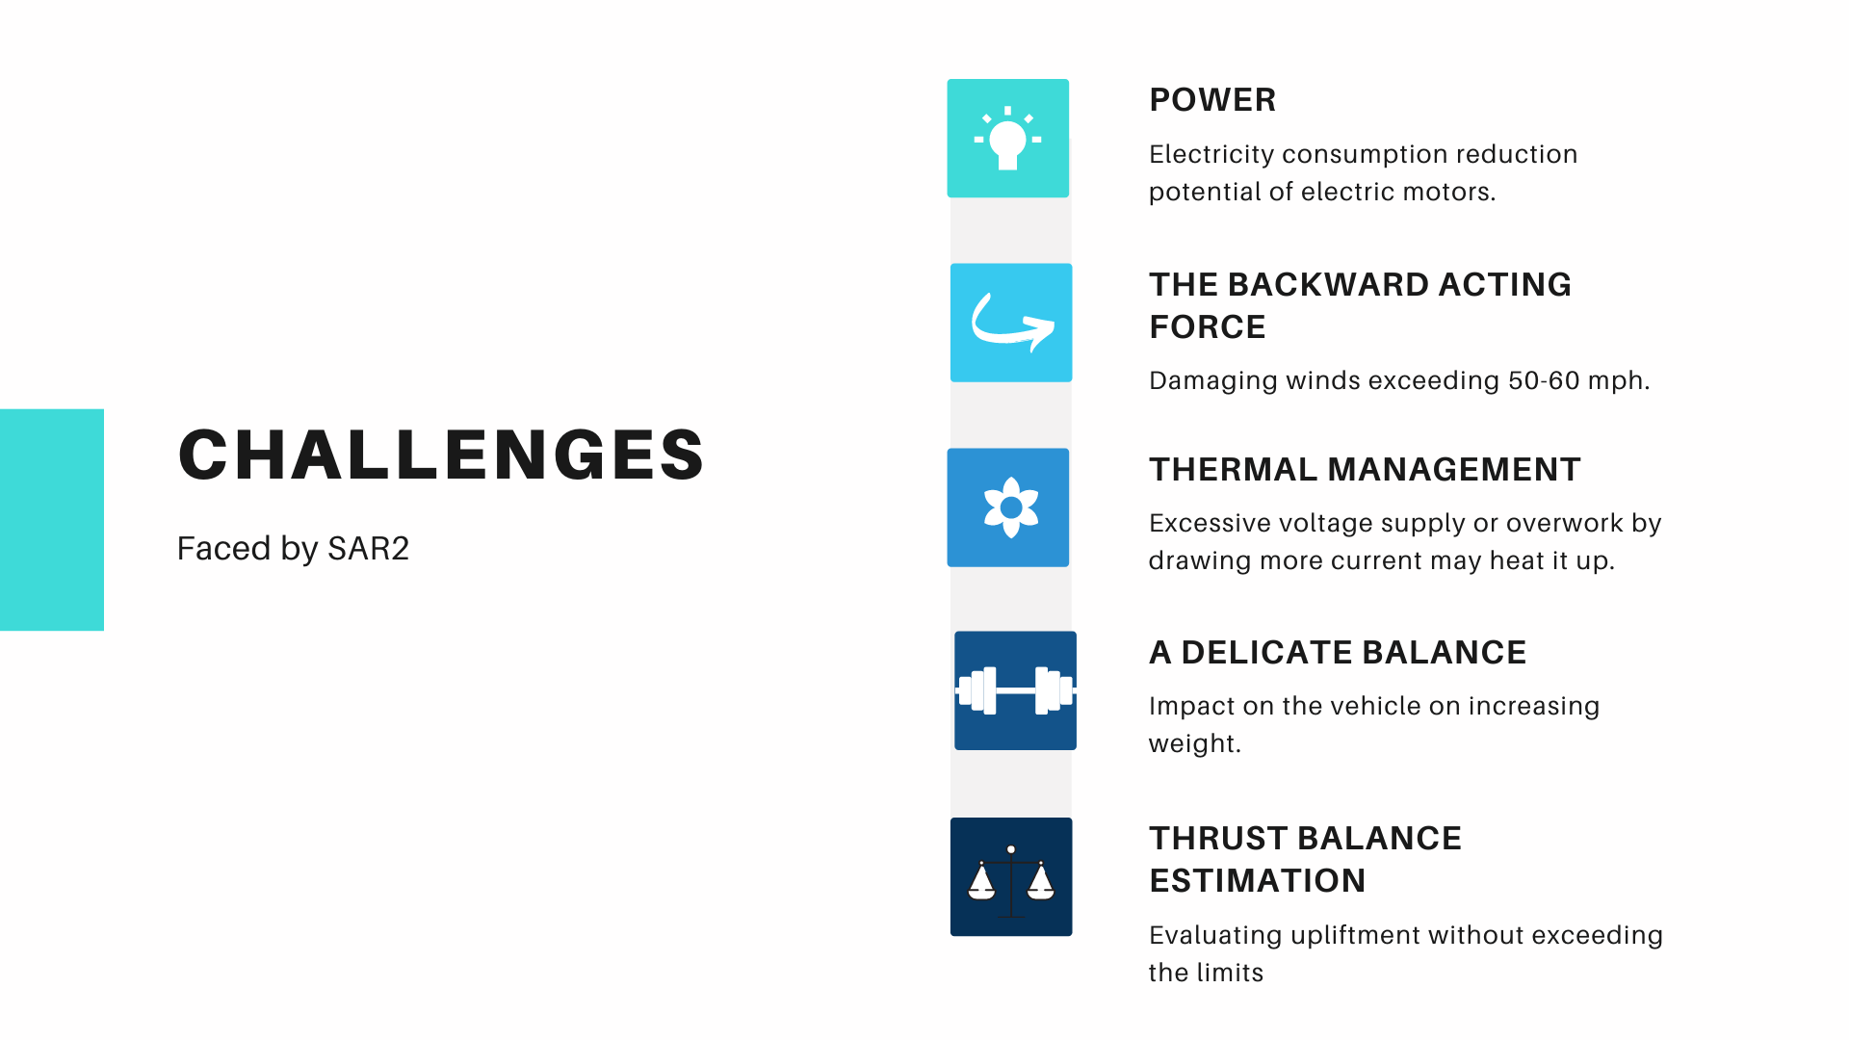

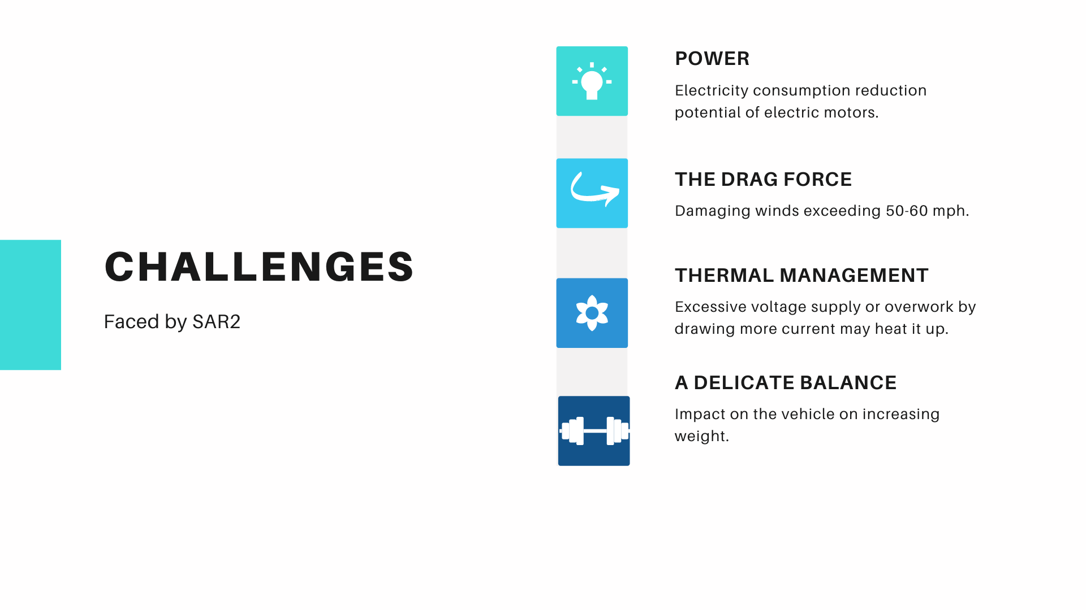
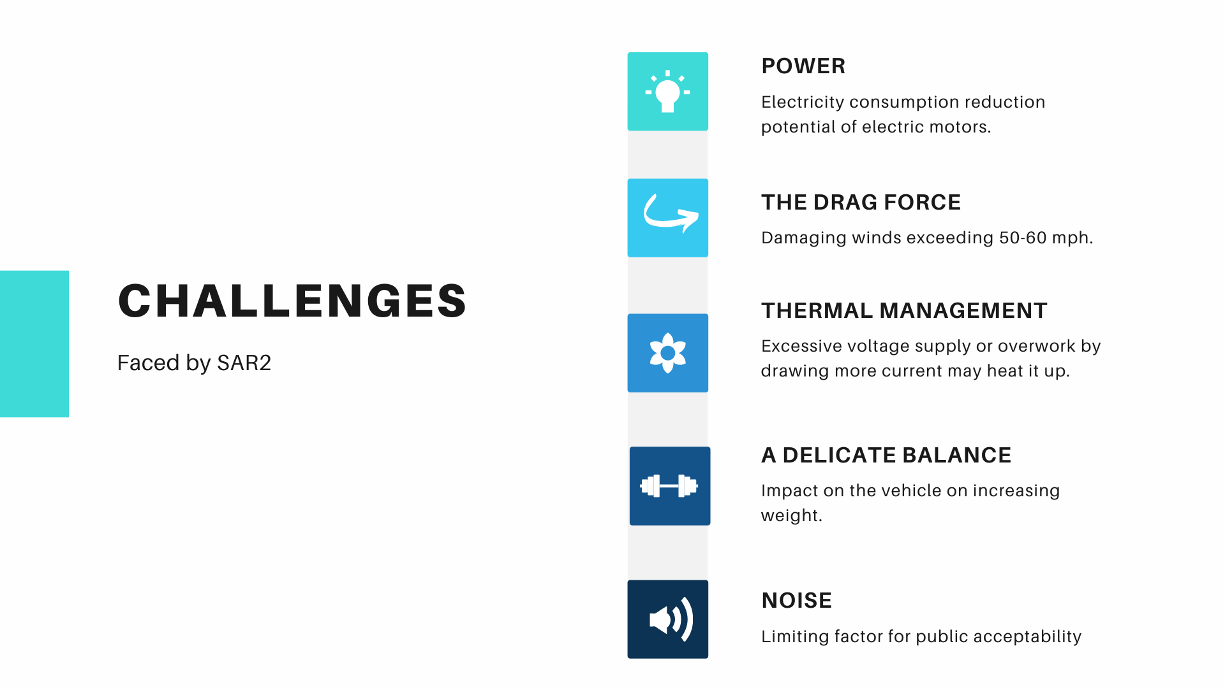

Slide 9
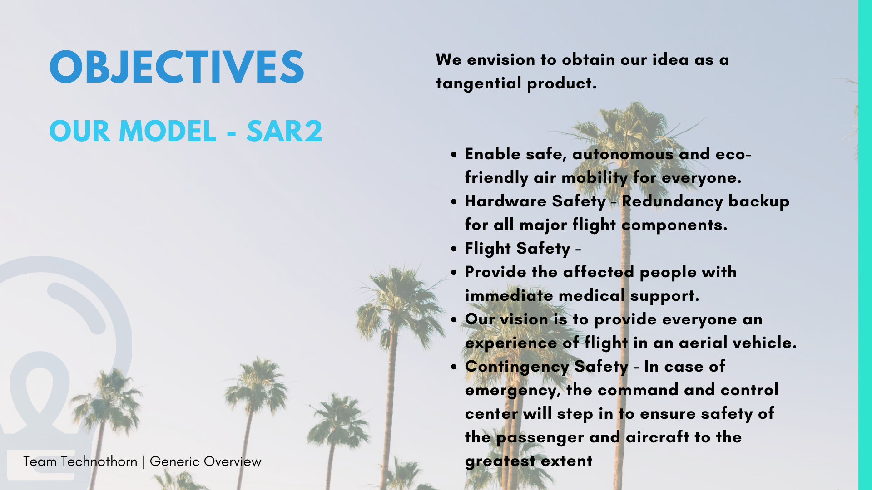
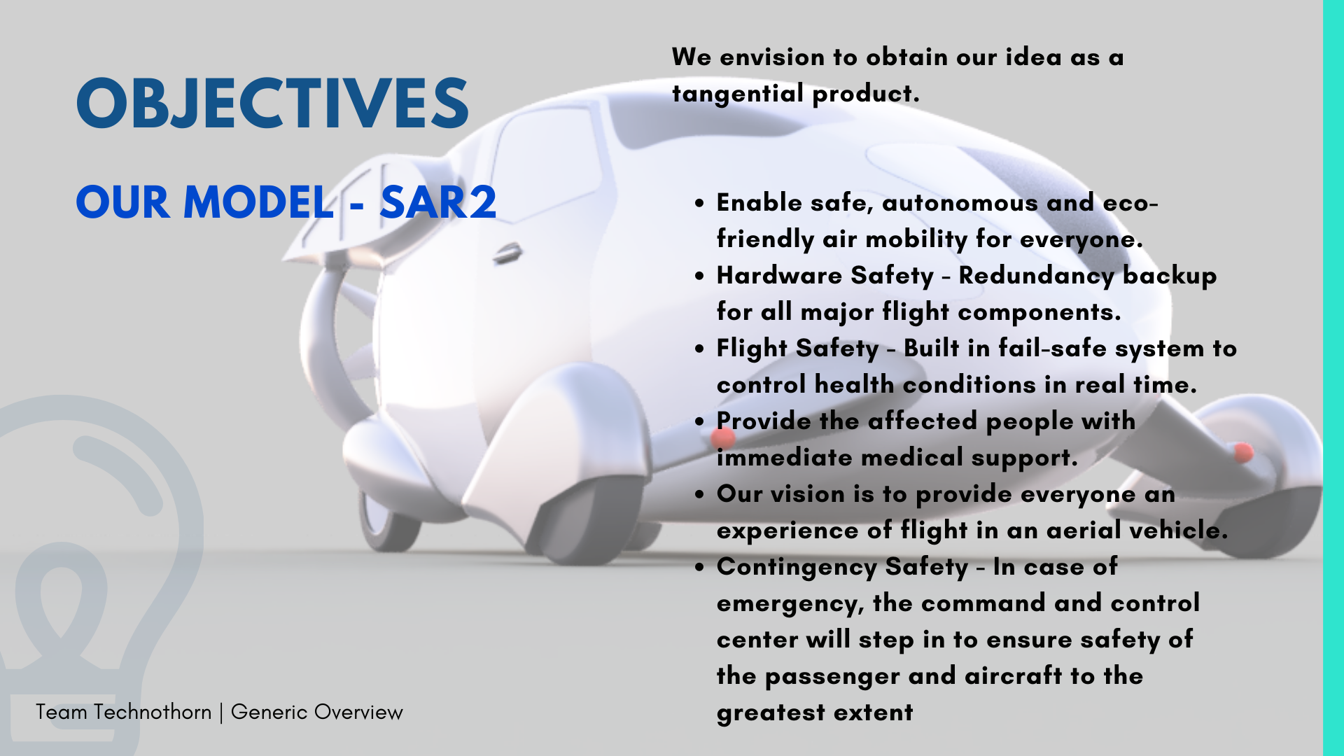
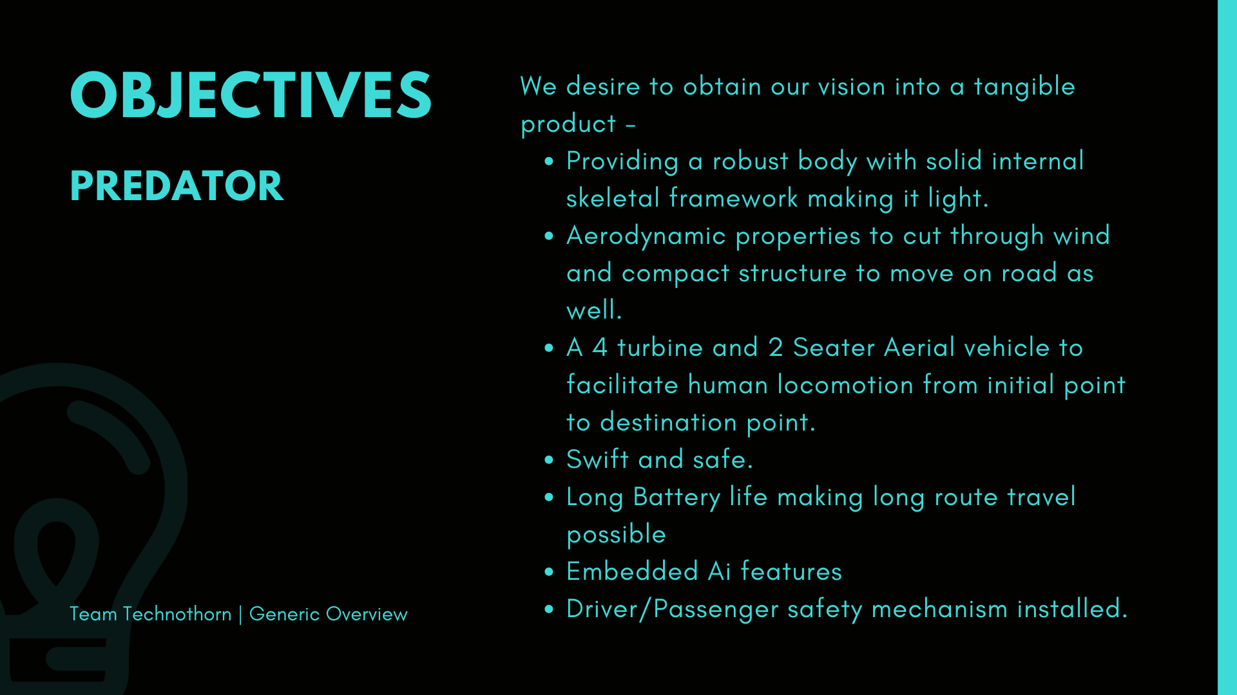
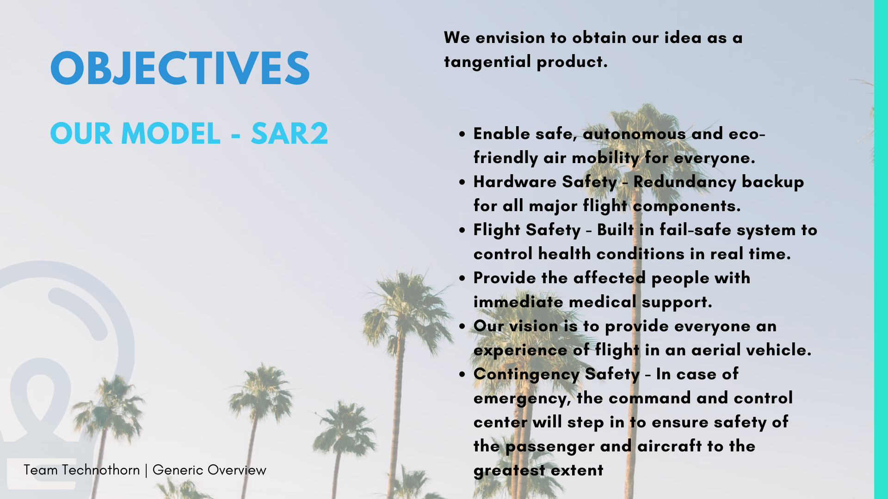


Slide 10
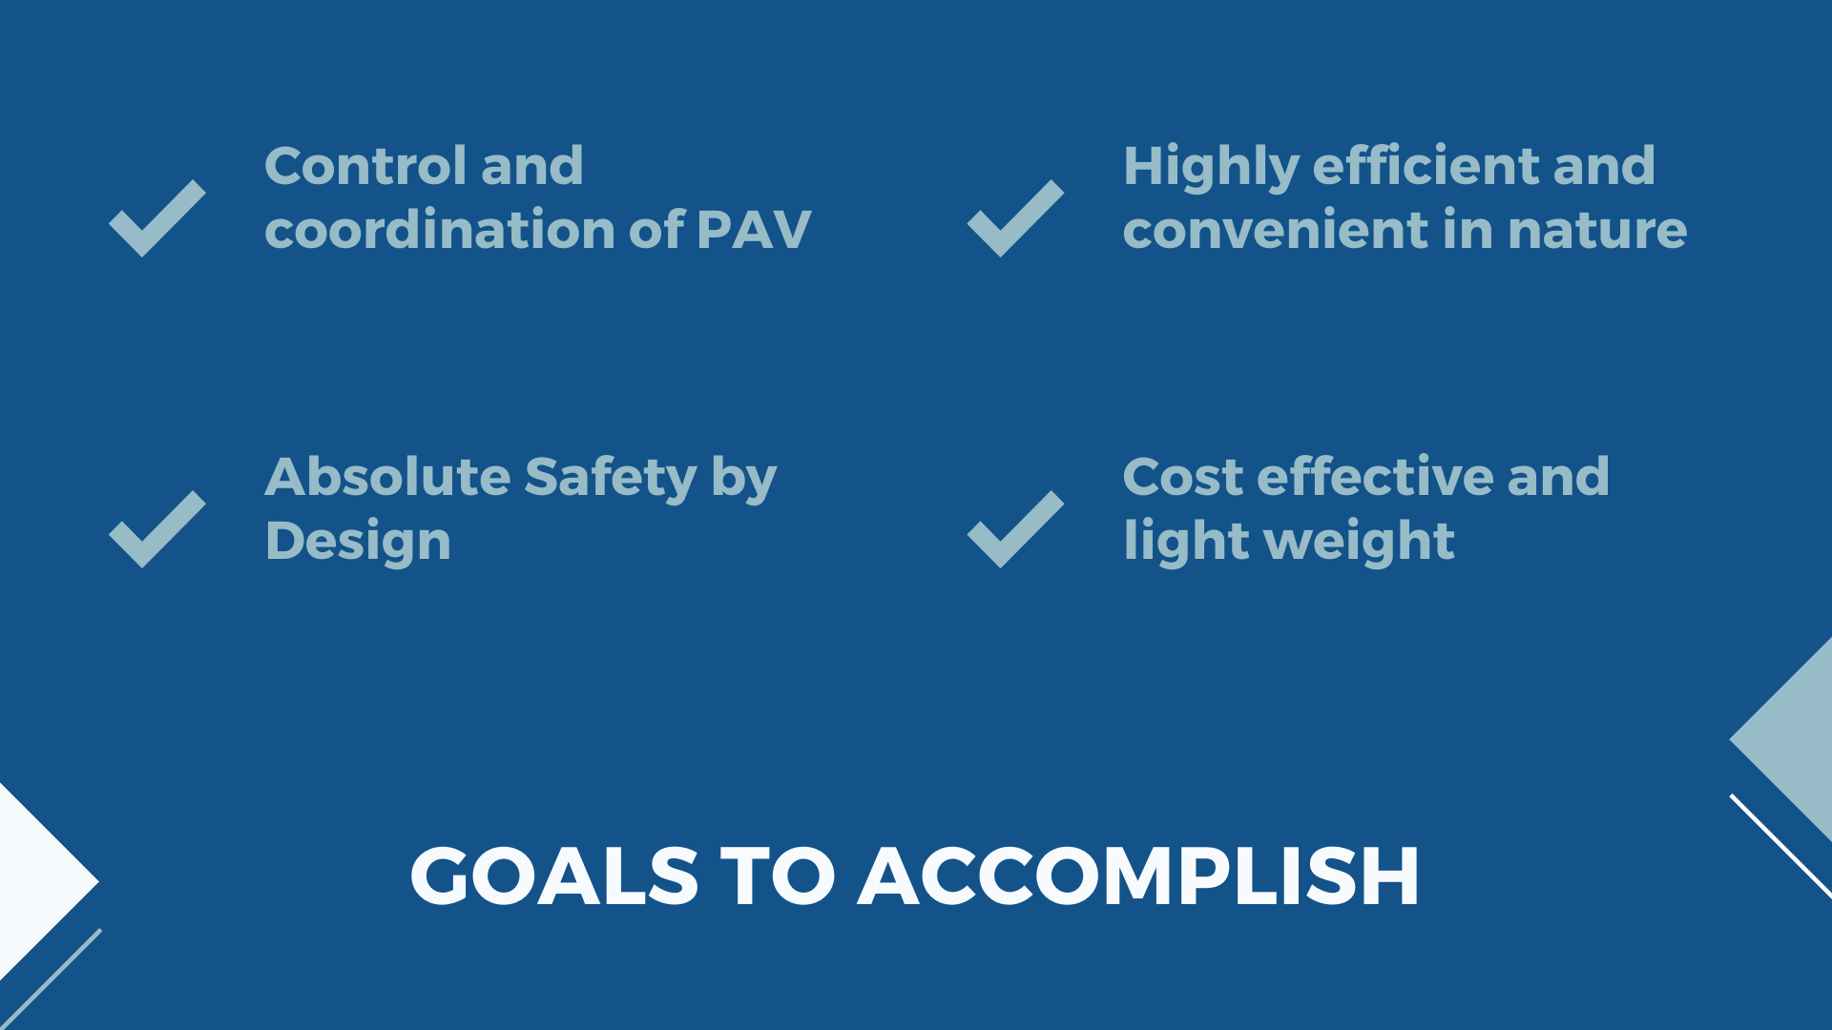

Slide 11
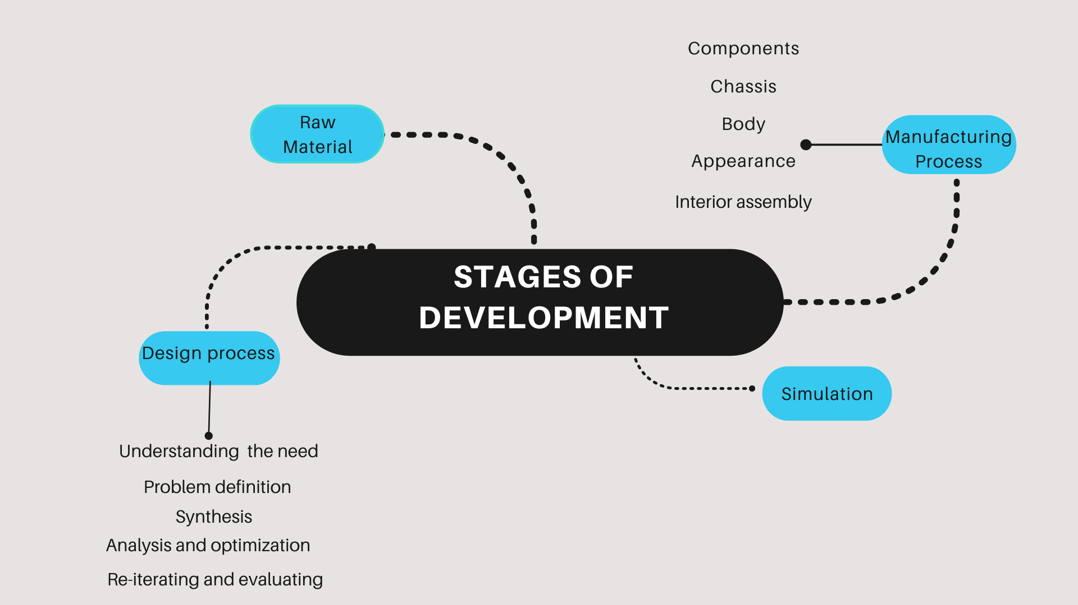

Slide 12
Key Features - SAR2
Speed - 90-100 km/hr (approx)
Height - 4.4 m
Width - 1.4 m
Weight - 550 kg
Total Power Supply - 450 HP [400(main requirement) + 50(reserve)]
Service ceiling - 1000 m (3281 ft)
Driver Safety Mechanism
2 Seater (Driver/Passenger)
Foldable wings
Motor Speed - 3000 rpm
Lithium-polymer battery
Comprehensive Management by the smart command and Control Center
Radiator to regulate the heat generated inside the system
Electrically powered to reduce environmental harm caused by emission
Vertical take-off and landing
Team Technothorn

Slide 13


Slide 14
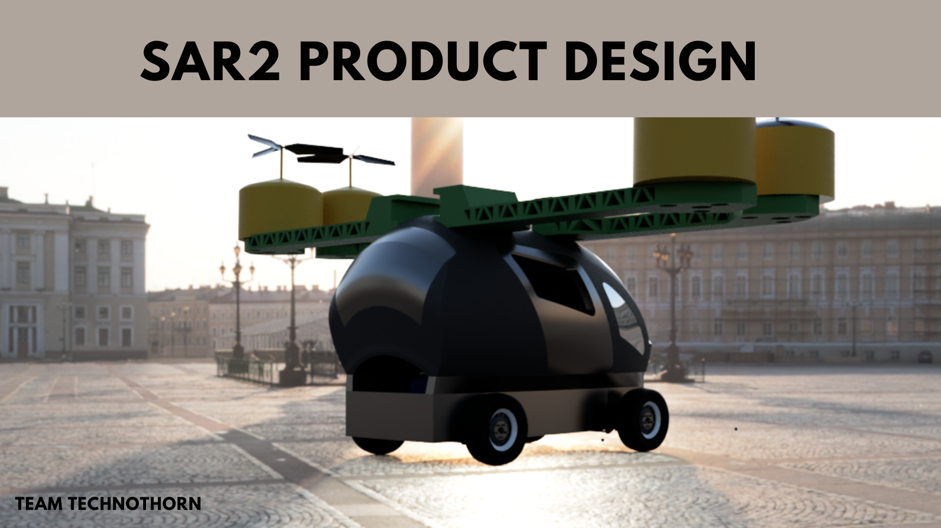

Slide 15
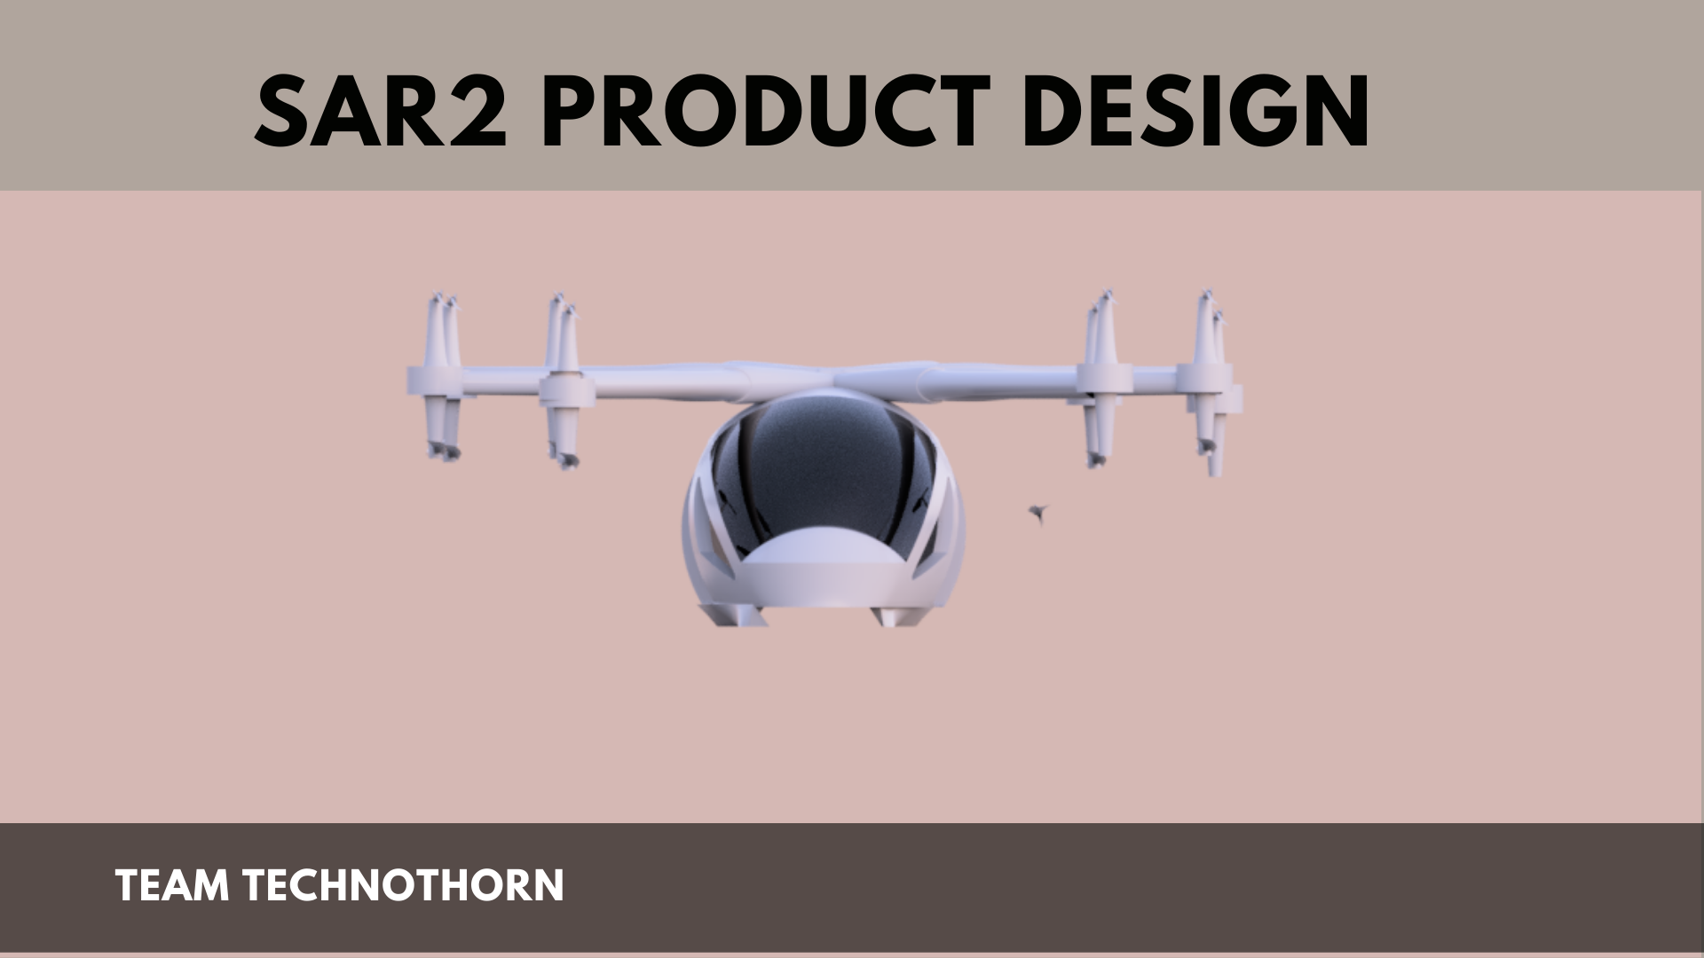
Final Product Image
# with every part description and specification
# a small rendered video if possible to be appended.
# add mission and vision
# add AI features slide.

Slide 16
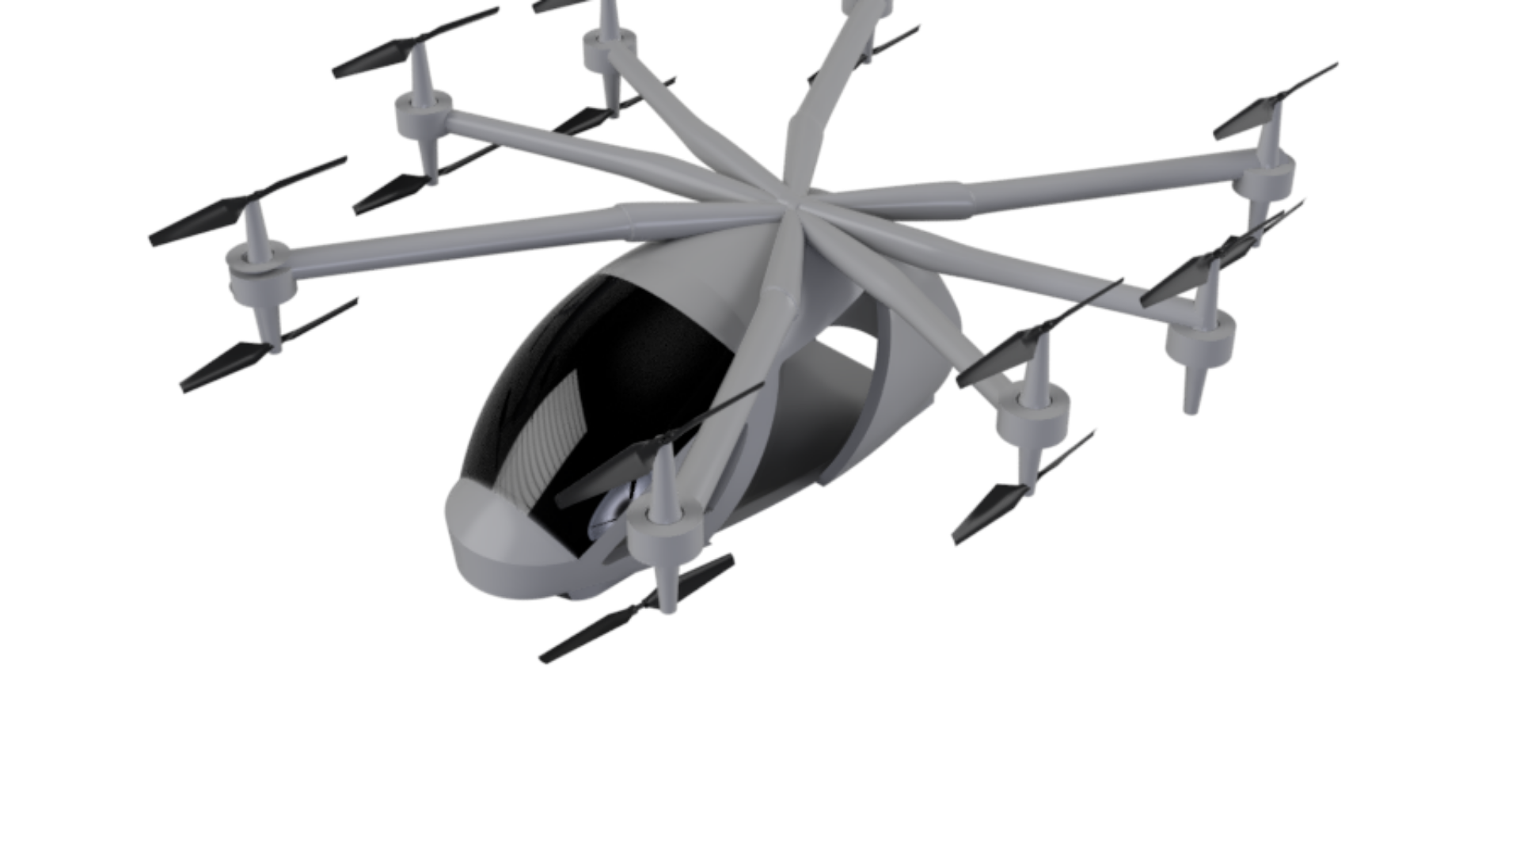

Slide 17
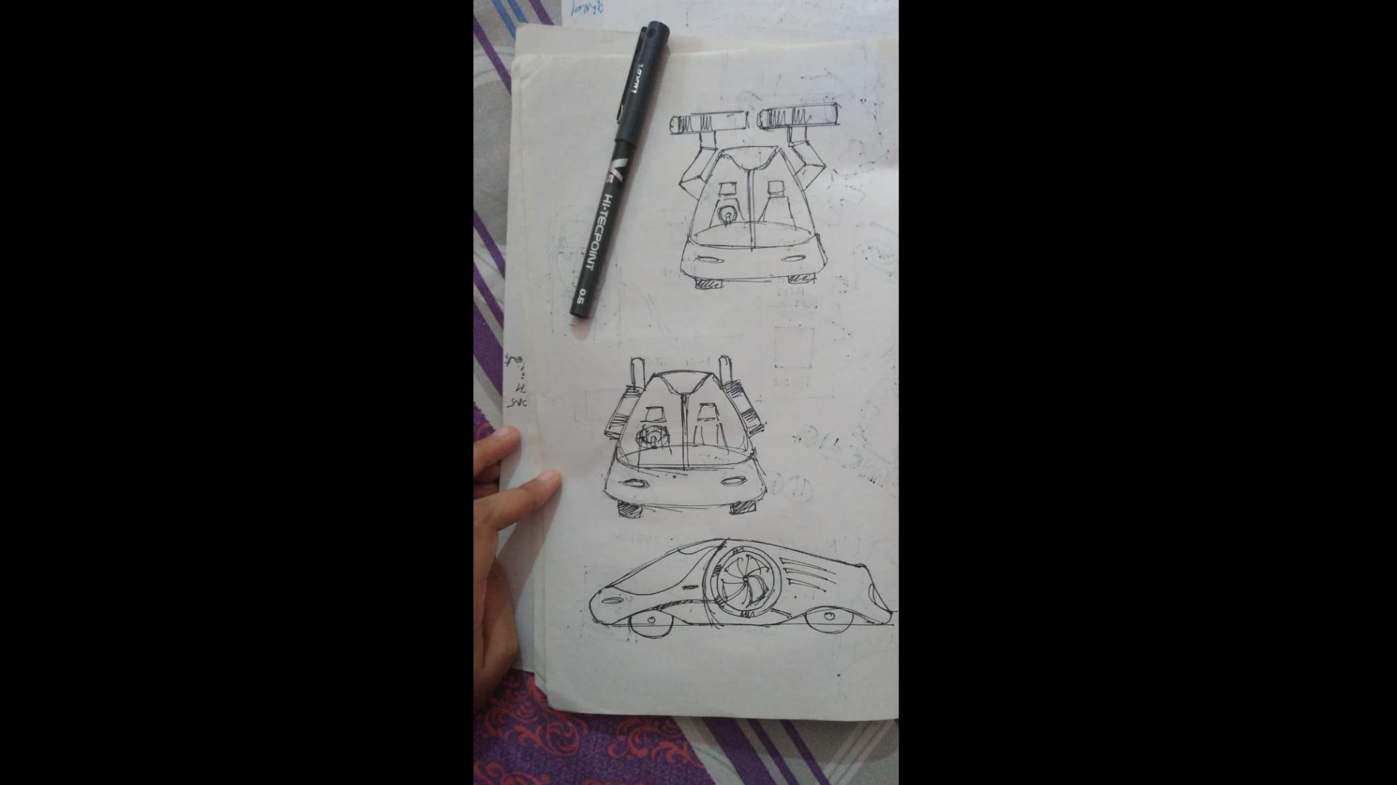

Slide 18
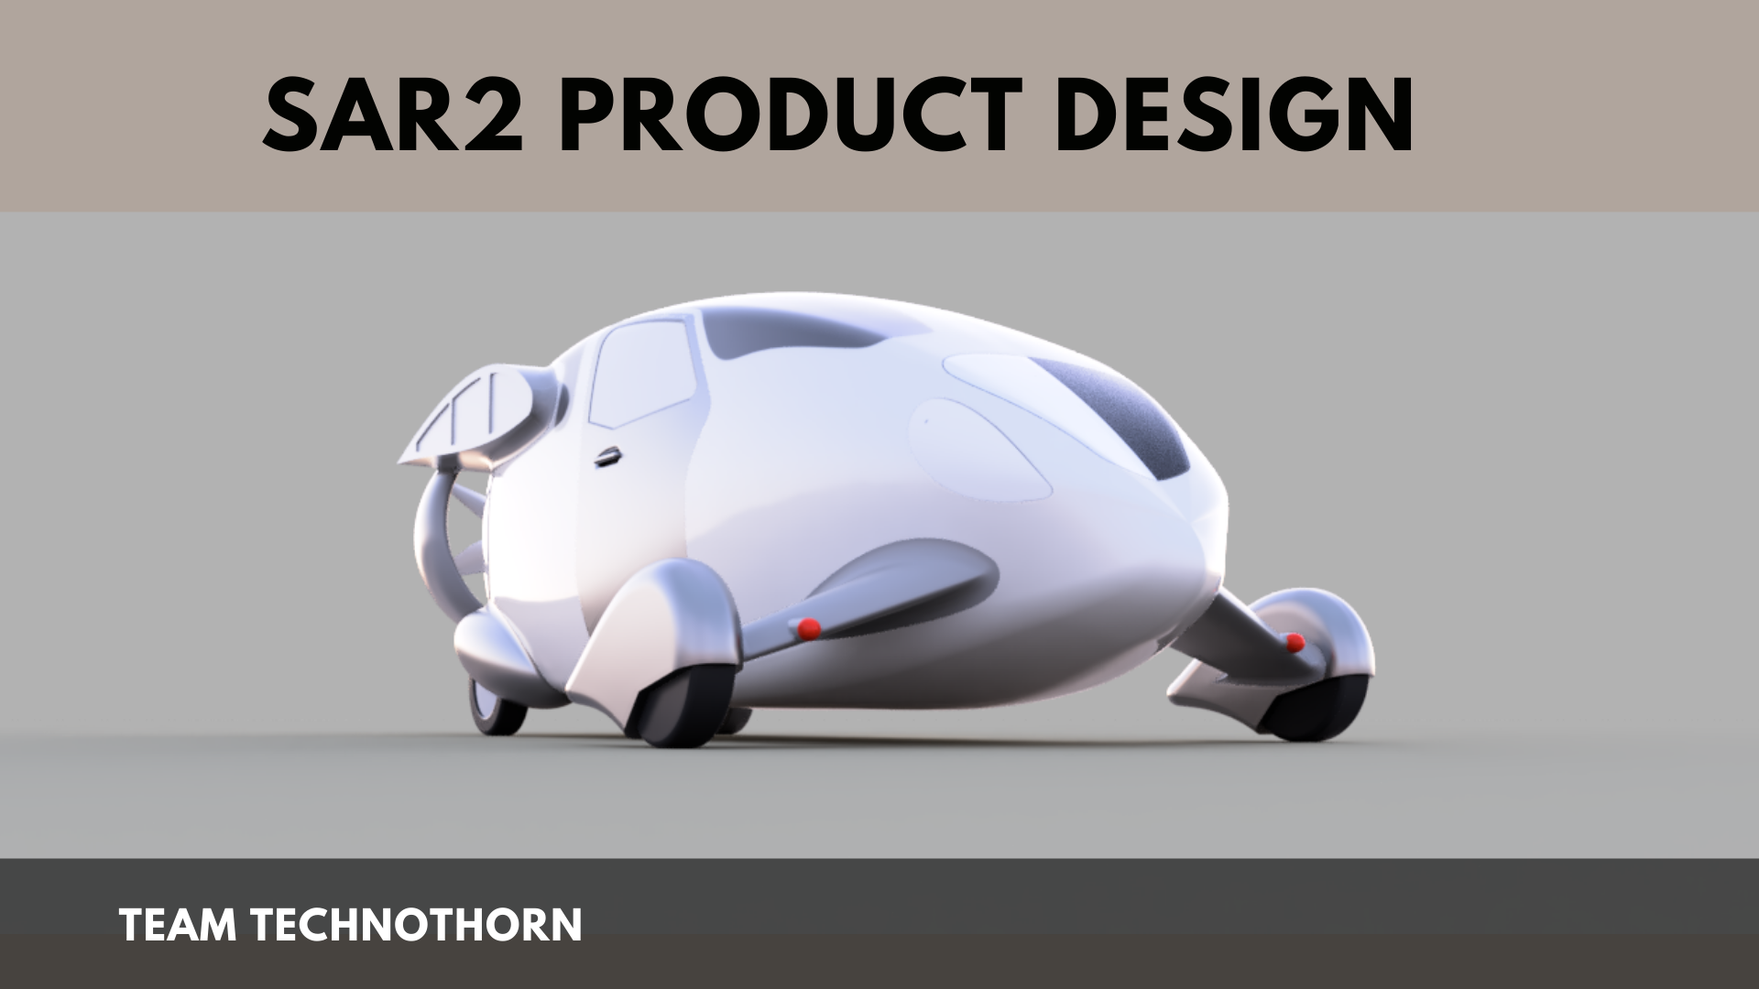

Slide 19
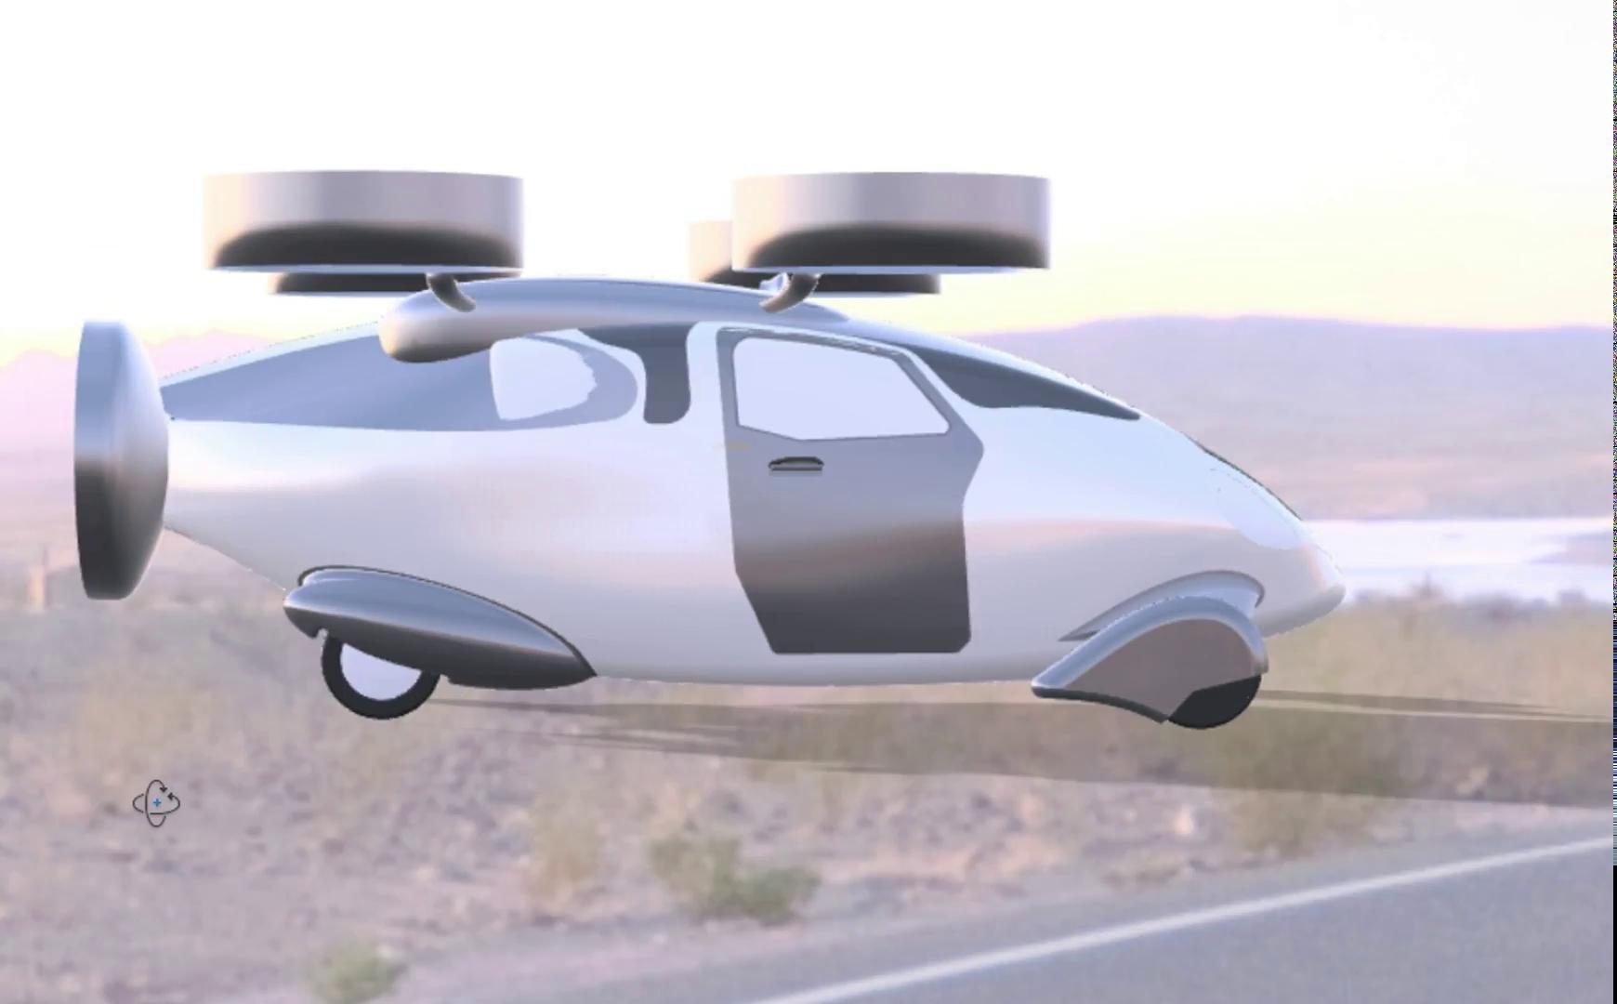

Slide 20



OPEN FOR SUGGESTIONS

